Slide 1
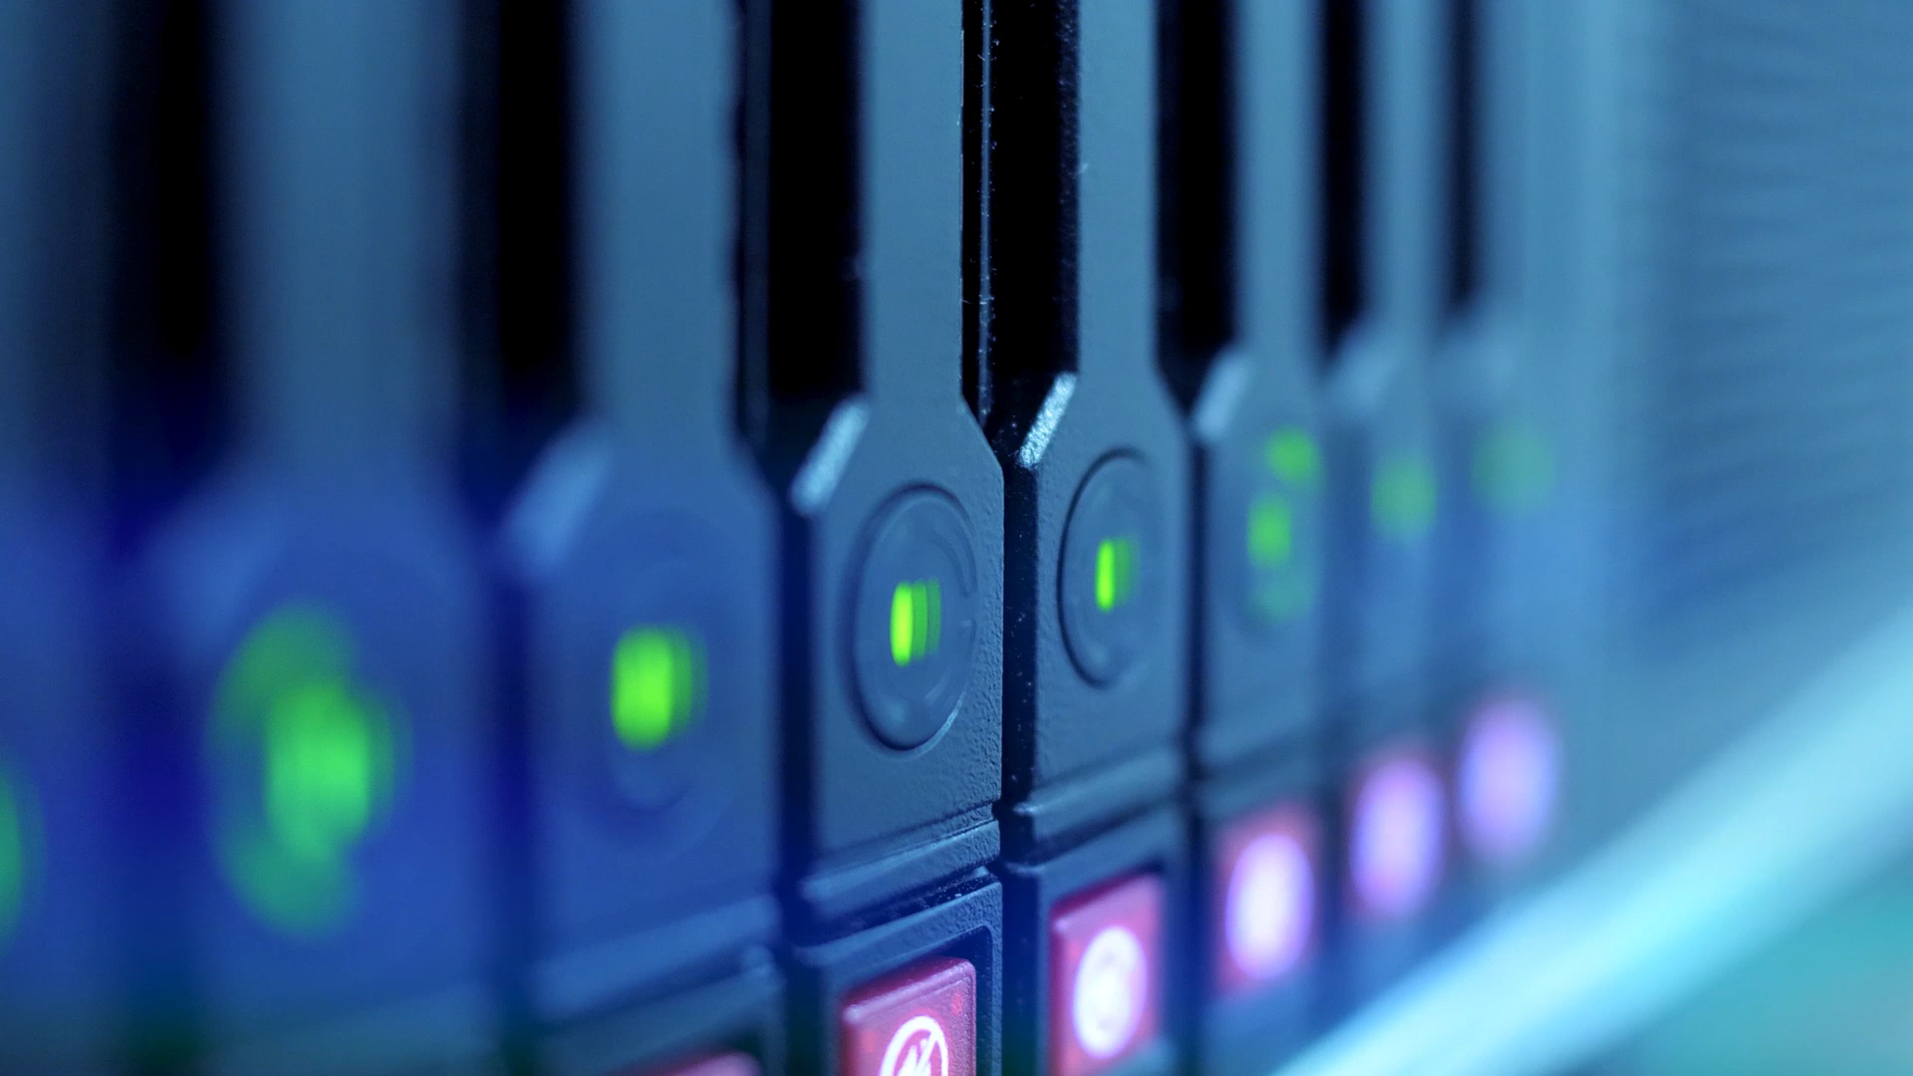
Automatic Number Plate Detection
Yashwanth Sai Tirukkovalluru
&
Sandipta Subir Khare

Slide 2
Why automatic number plate detection (anpr)?
ANPR is used by police forces around the world for law enforcement purposes, including to check if a vehicle is registered or licensed. It is also used for electronic toll collection on pay-per-use roads and as a method of cataloguing the movements of traffic, for example by highways agencies. ANPR cameras are an efficient and cost-effective way to monitor parking solutions. In car parks, they negate the need for parking wardens. Thanks to their high-accuracy readings and 24/7 operation, they are more efficient than most individuals and therefore provide a more dependable service. The number plate condition, non-standardized formats, complex scenes, camera quality, camera mount position, tolerance to distortion, motion-blur, contrast problems, reflections, processing and memory limitations, environmental conditions, indoor/outdoor or day/night shots, software-tools or other hardware-based constraint may undermine its performance. The performance rate involves all the three stages of recognition process, number plate extraction, segmentation and character recognition.

Slide 3
Tools and libraries used in this project
Pandas
Numpy
Matplotlib
OS
OpenCV
Sklearn
TensorFlow / Keras

Slide 4
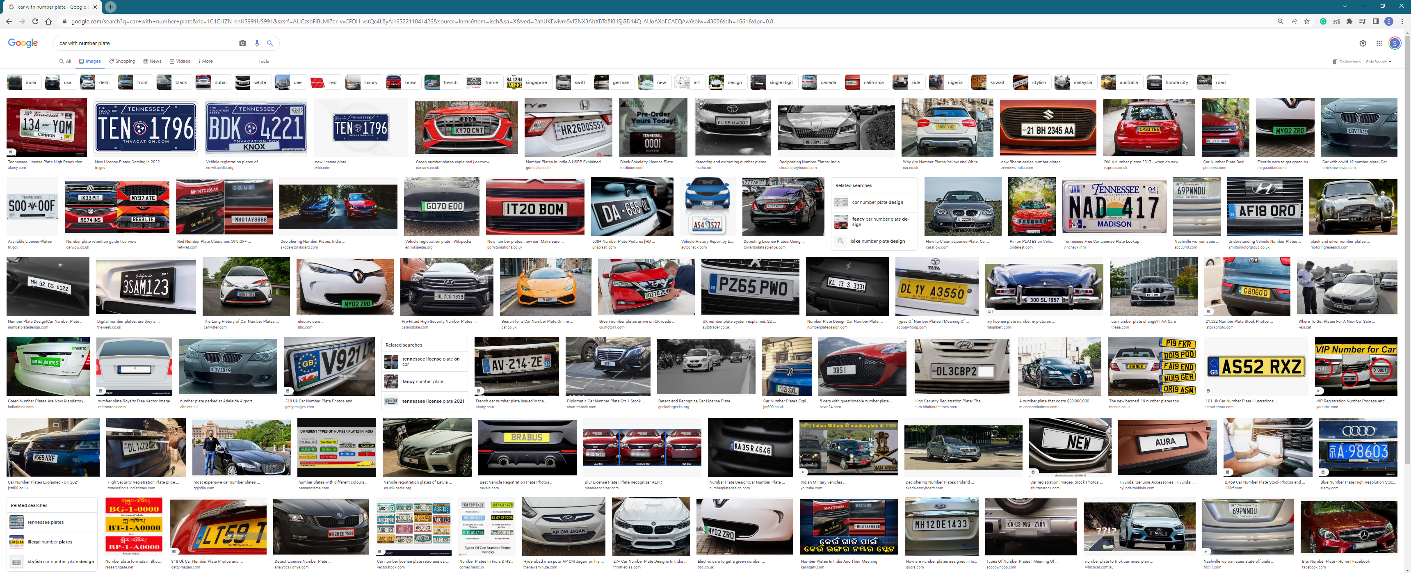
Datasets:

Slide 5
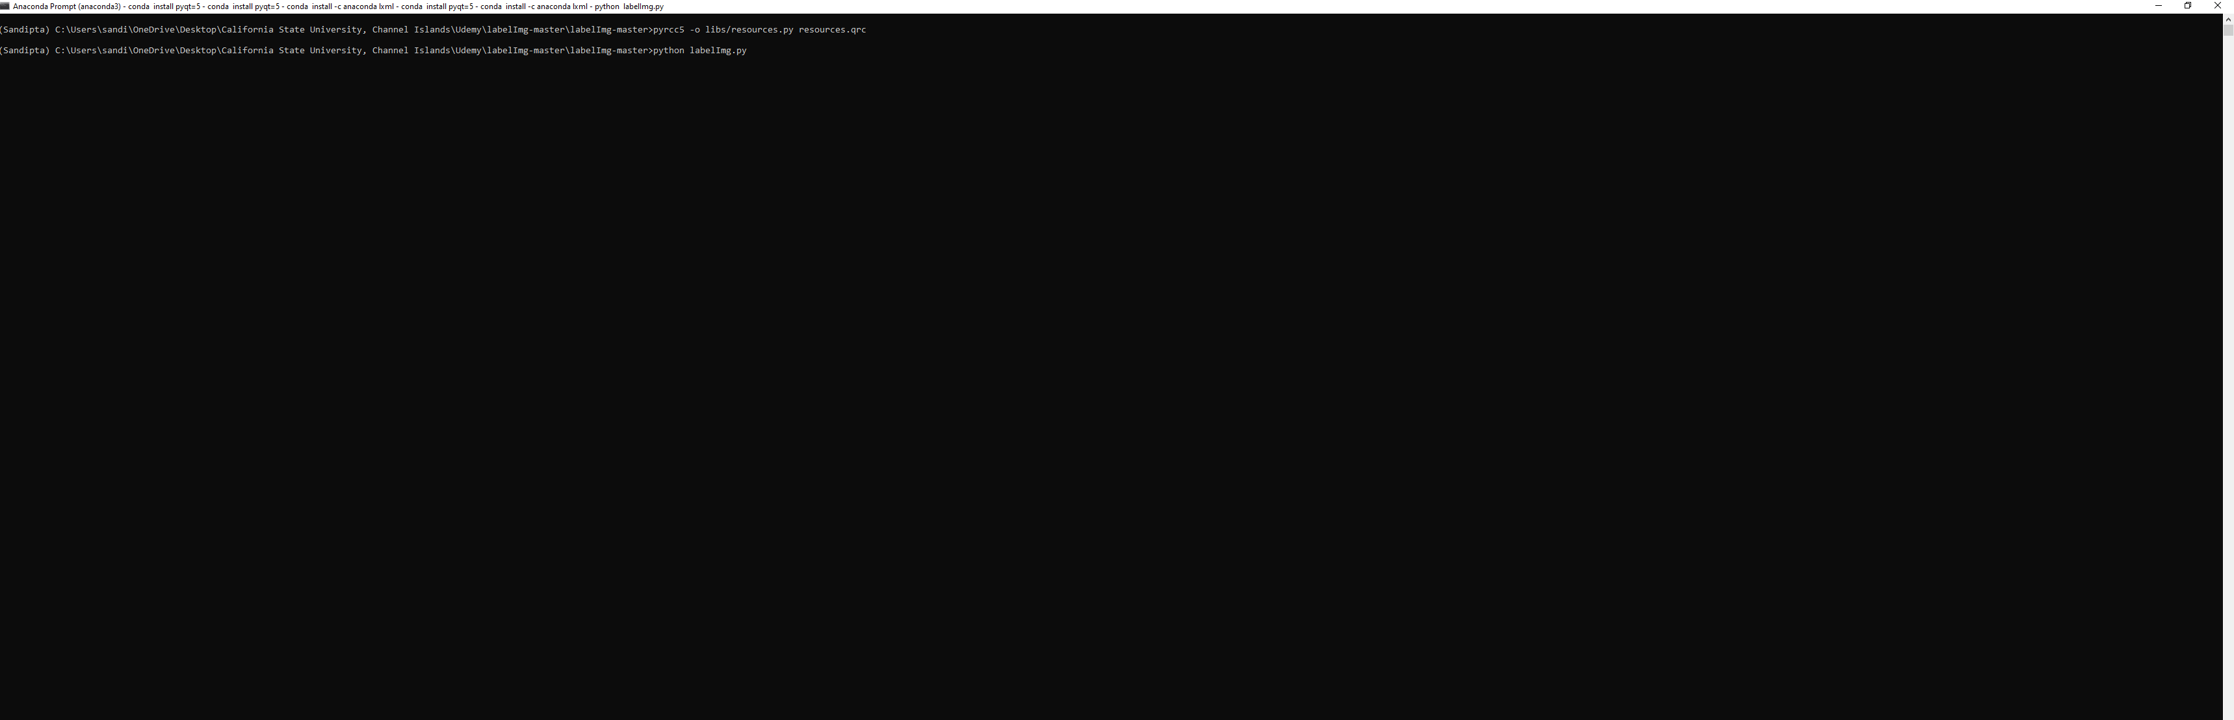
Image file into xml file
Step-01: We opened Anaconda Prompt. We install two libraries before converting jpeg file into xml file and that are:
pyqt
Anaconda lxml
After installation of both the libraries we ran following two commands:
pyrcc5 –o libs/resources.py recourses.qrc
python labelImg.py

Slide 6
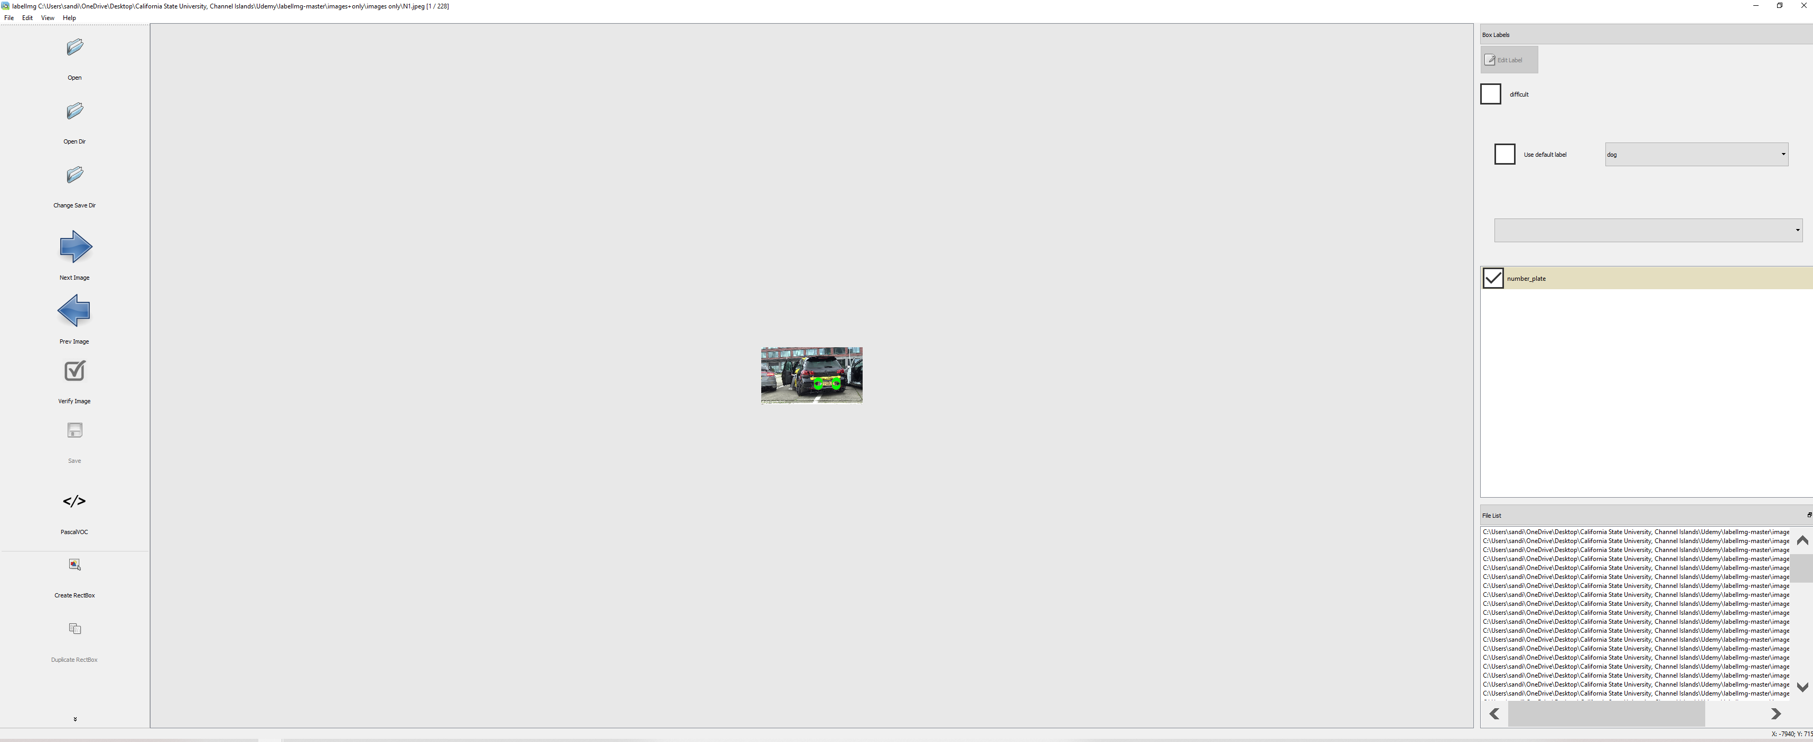
Conversation of jpeg to xml file
Step 2:
pyrcc5 –o libs/resources.py recourses.qrc
python labelImg.py
After running “python labelImg.py” command, we got the labelImg dialog box.
Here, we set path from where image can be imported, and we can convert the file into xml file.

Slide 7
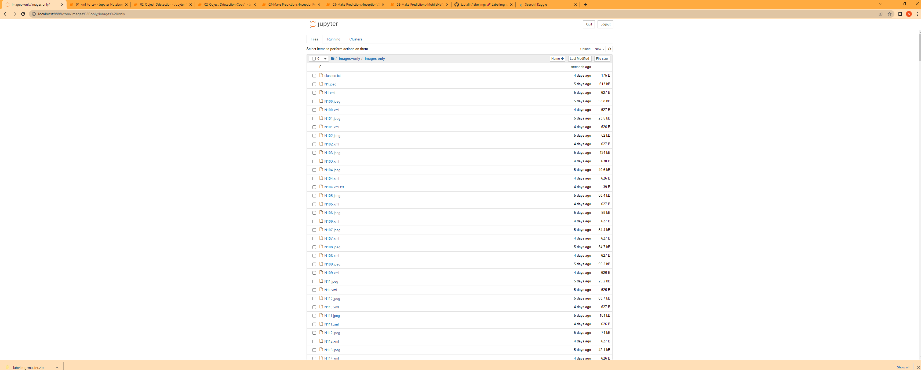
Jpeg to xml

Slide 8
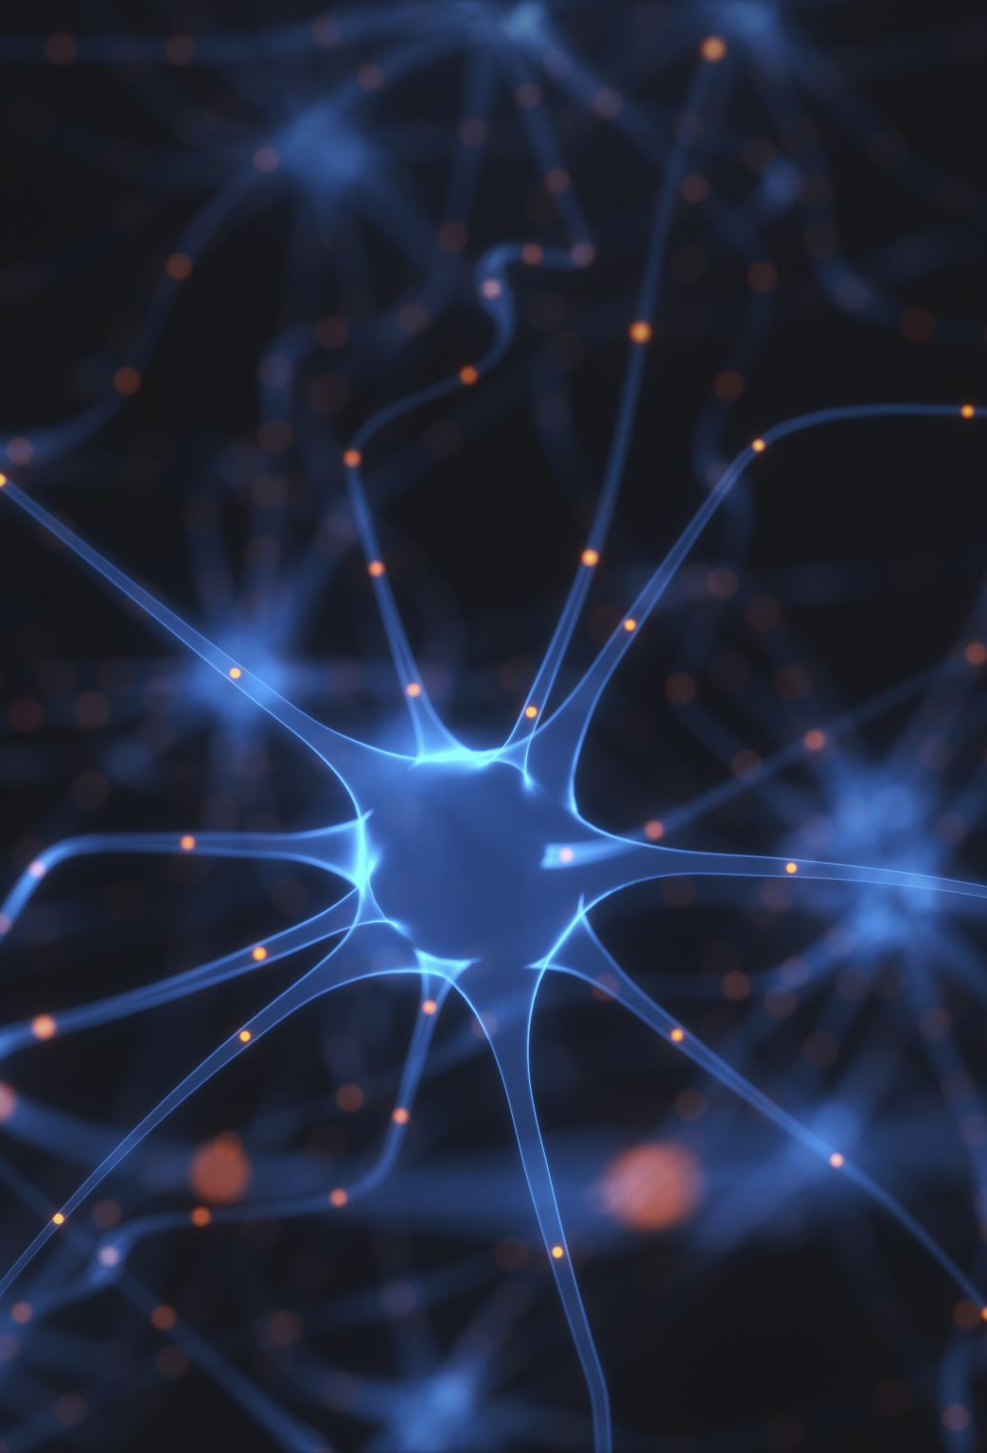
Neural network algorithms:
We worked on 3 major neural network algorithms, which are as follows:
InceptionResnetV2
InceptionV3
MobileNetV2

Slide 9
Inception-ResNet-v2 is a convolutional neural network that is trained on more than a million images from the ImageNet database. The network is 164 layers deep and can classify images
What is Inception-v3 used for?
Inception v3 is a convolutional neural network for assisting in image analysis and object detection and got its start as a module for Googlenet. It is the third edition of Google's Inception Convolutional Neural Network, originally introduced during the ImageNet Recognition Challenge.
Inception v3 is an image recognition model that has been shown to attain greater than 78.1% accuracy on the ImageNet dataset. The model is the culmination of many ideas developed by multiple researchers over the years.
Inception-v3 is a convolutional neural network that is 48 layers deep. You can load a pretrained version of the network trained on more than a million images from the ImageNet database. The pretrained network can classify images into 1000 object categories, such as keyboard, mouse, pencil, and many animals.

Slide 10
MobileNetV2 is a convolutional neural network architecture that seeks to perform well on mobile devices. It is based on an inverted residual structure where the residual connections are between the bottleneck layers.
The pretrained MobileNetV2 1.0 achieves 72.834% top-1 accuracy and 91.060% top-5 accuracy on ImageNet validation set, which is higher than the statistics reported in the original paper and official TensorFlow implementation.

Slide 11
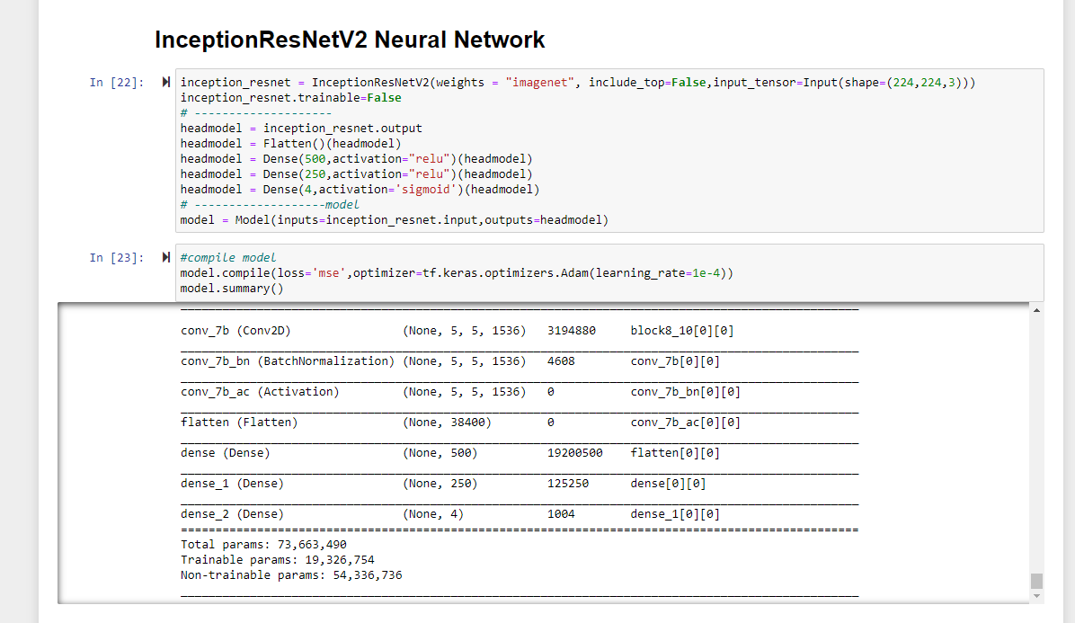
Compilation of model inceptionresnetv2

Slide 12
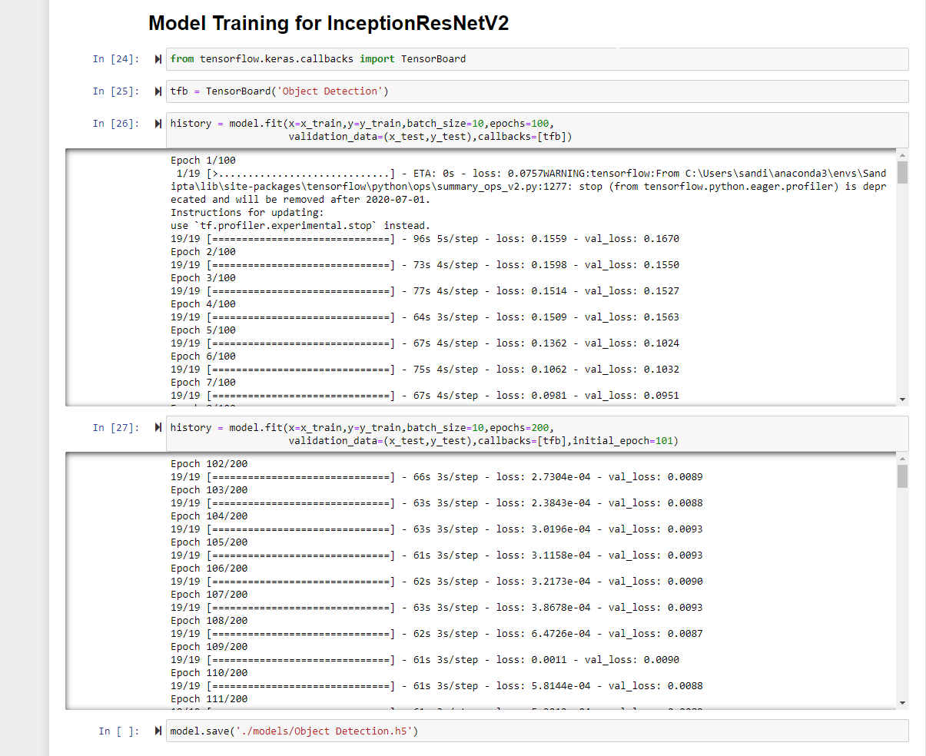
Inceptionresnetv2 model training

Slide 13
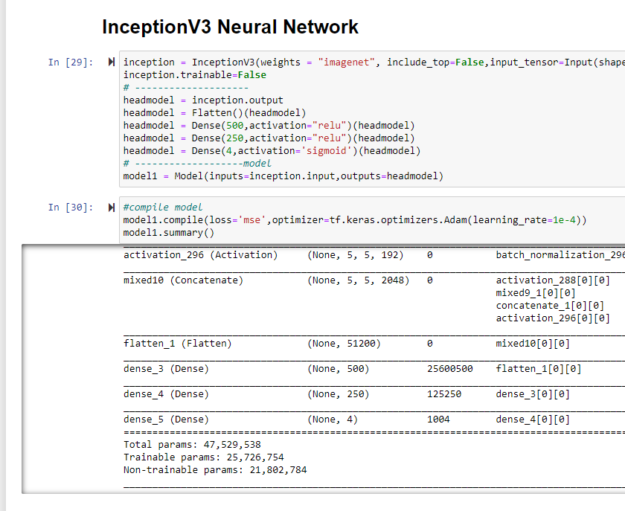
Compilation of model Inceptionv3

Slide 14
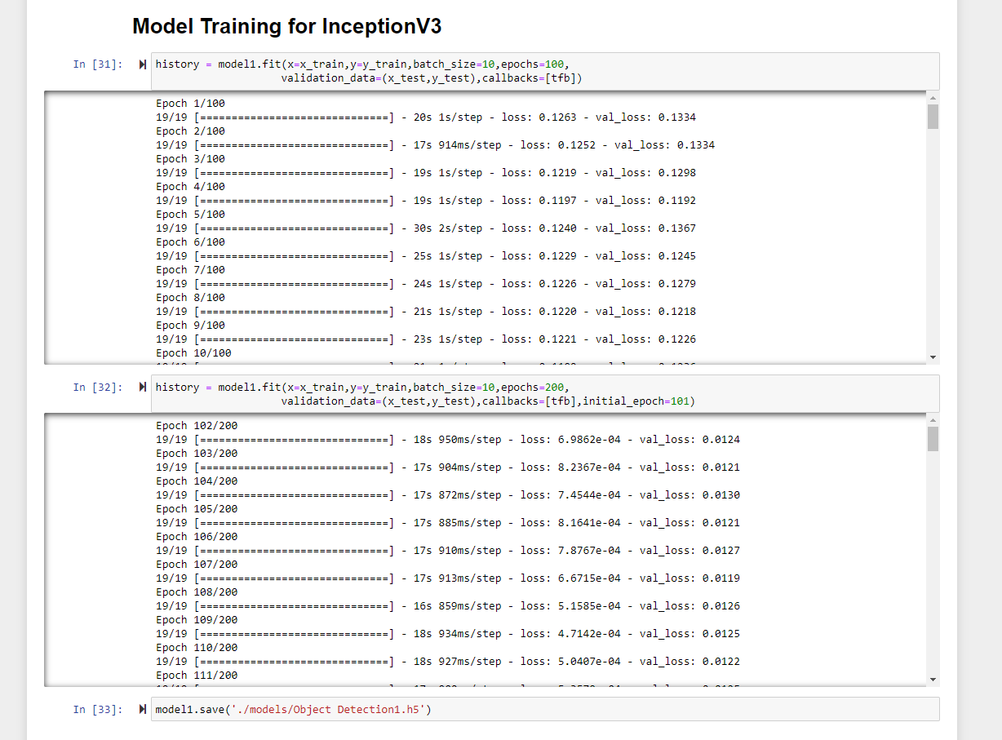
Inceptionv3 model training

Slide 15
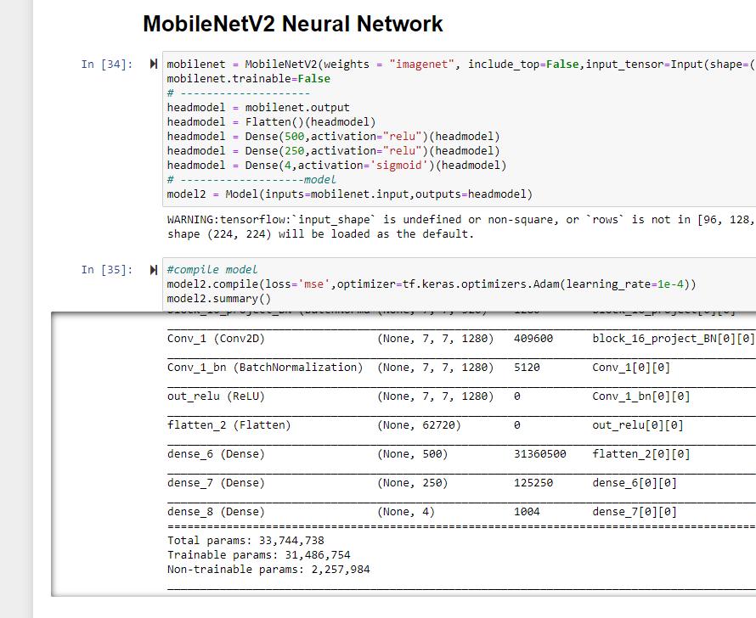
Compilation of model mobilenetv2

Slide 16
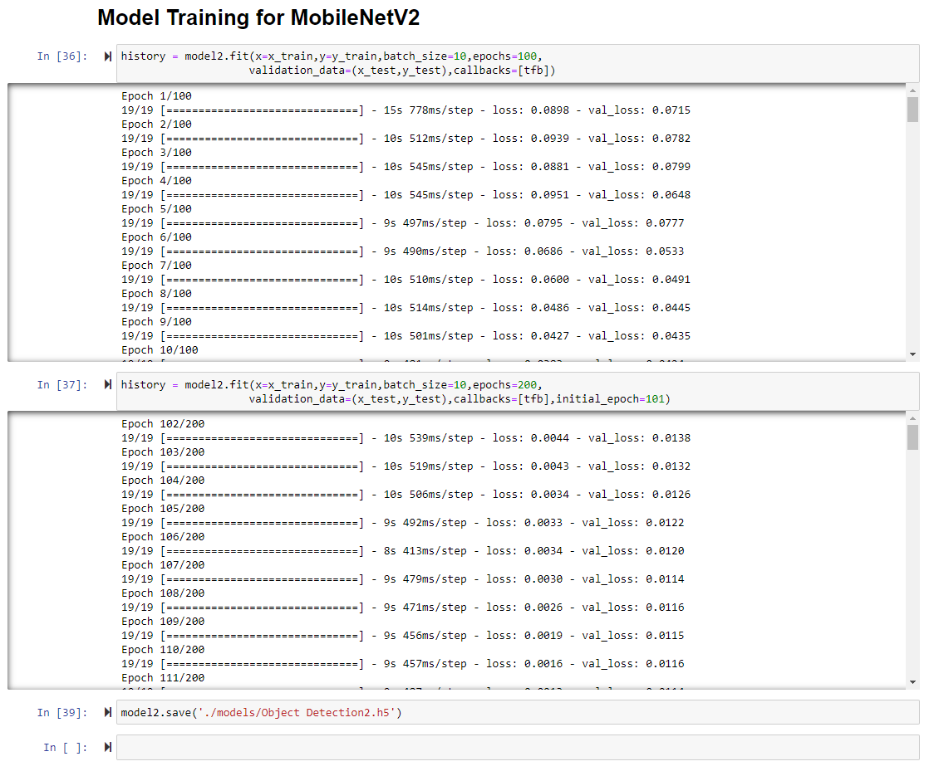
Mobilenetv2 model training

Slide 17
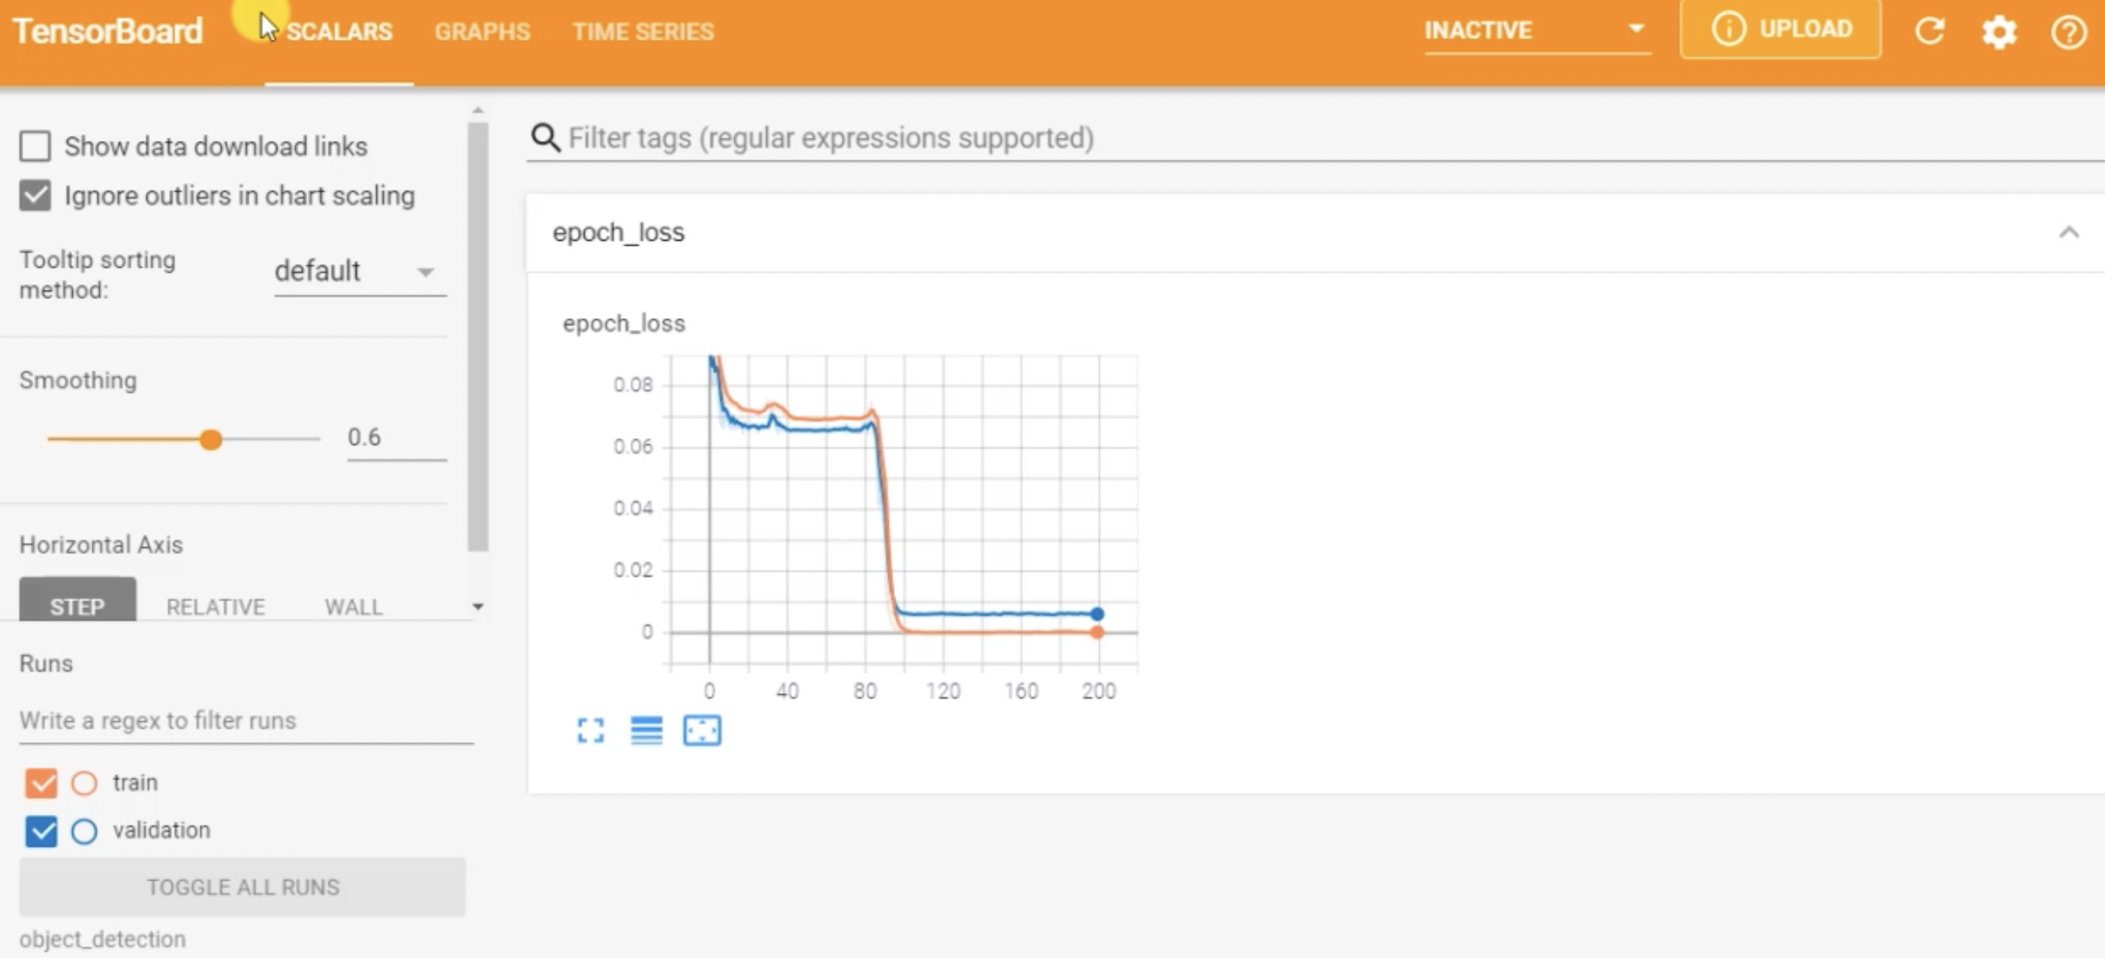
Tensorboard

Slide 18
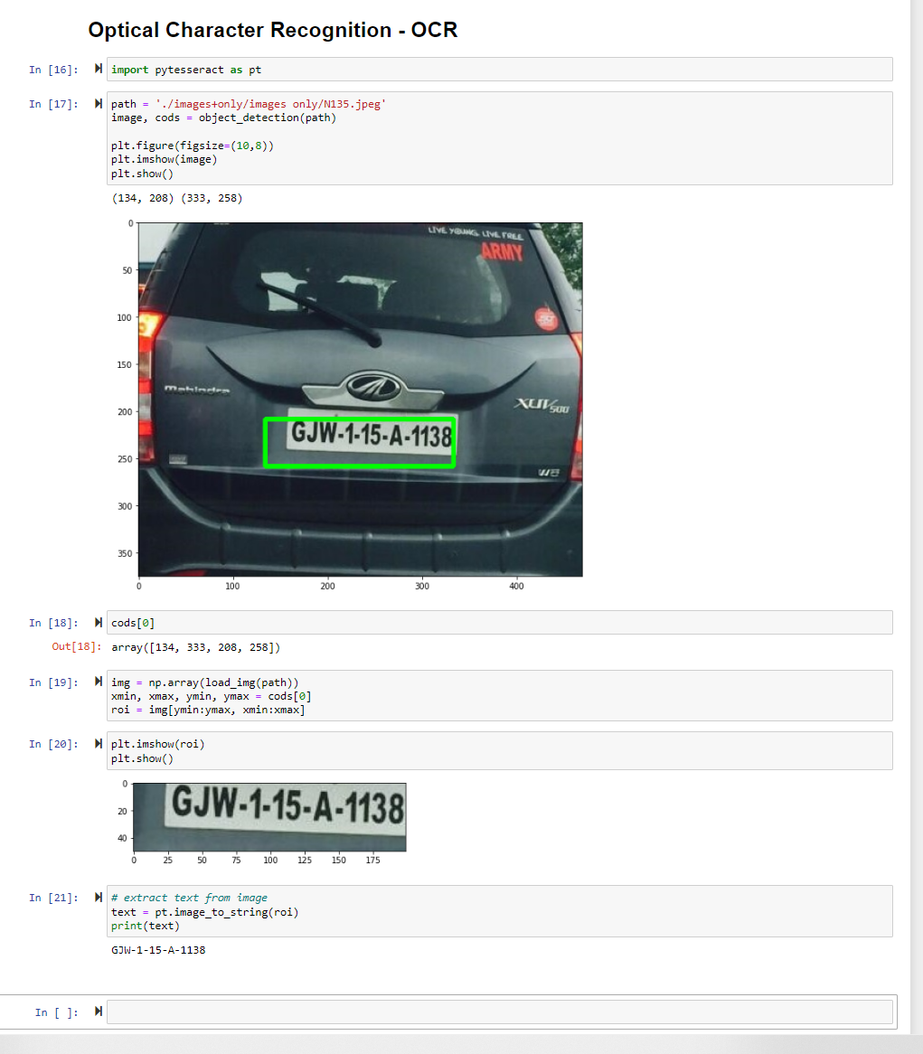
Prediction

Slide 19
OCR – Optical character recognition
We used Tesseract and Pytesseract to extract the text from the image.
Tesseract: is an open-source text recognition engine, available under the Apache 2.0 license. It can be used directly or using an API to extract printed text from images.
Some of the limitations of tesseract are it will not work on handwritten text, edited images and resolution should be 200dpi width and 300 pixels height. .

Slide 20
FUTURE WORK
We worked on limited amount of data, so we need to work on improving the dataset
Planning to work on more algorithms to measure the performance
Deployment in cloud

Slide 21
reference
https://www.ncbi.nlm.nih.gov/pmc/articles/PMC8123416/
https://www.dev2qa.com/how-to-fix-could-not-install-packages-due-to-an-environmenterror-winerror-5-access-is-denied-error-when-install-python-module-in-windows/
https://stackoverflow.com/questions/67120450/error-2unspecified-error-the-function-is-not-implemented-rebuild-the-libra
https://www.youtube.com/watch?v=WA5Gy32aqdo
https://www.youtube.com/watch?v=COBClFEQQJk

Slide 22
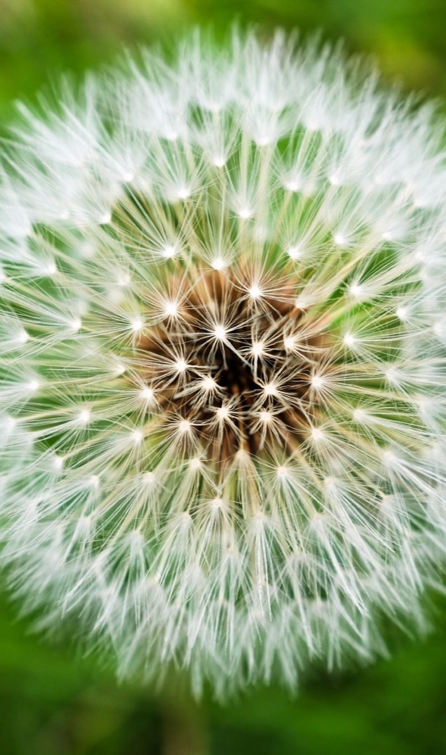
Thanking you…….!!!!!!

